Slide 1
Project 1: Linear Feature Engineering
Reporters: Ye Zheng and Shafizur Rahman Seeam

Slide 2
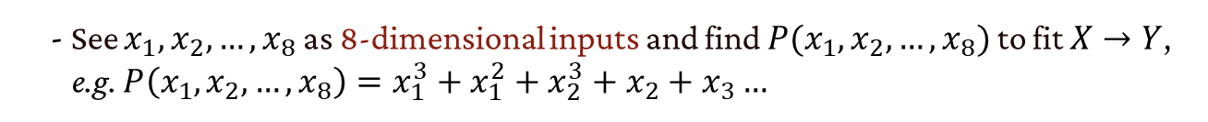
Two Methods
• Given the training data $X=\{x_{1},x_{2},…,x_{8}\}$ and its label $Y$:
- See $X$ as a whole part and find $P(X)$ to fit $X→Y$, e.g. $P\left(X\right)=X^{3}+X^{2}+√X$
- See $x_{1},x_{2},…,x_{8}$ as 8-dimensional inputs and find $P(x_{1},x_{2},…,x_{8})$ to fit $X→Y$,
e.g. $P\left(x_{1},x_{2},…,x_{8}\right)=x_{1}^{3}+x_{1}^{2}+x_{2}^{3}+x_{2}+x_{3}…$
• We choose the second method
Ye & Shafizur
Linear Feature Engineering
2

Slide 3
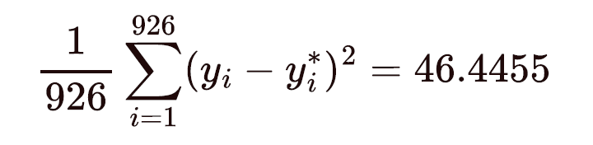
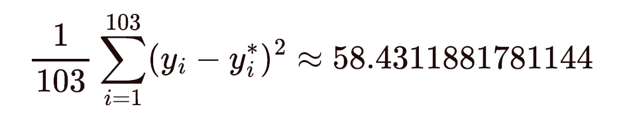
Error
• Our training error is:
• Our prediction for the final test error is:
Ye & Shafizur
Linear Feature Engineering
3

Slide 4
Features
• Our method finds a feature for each dimension $x_{i}$
• We assume the system can be approximated by a polynomial $P(x_{1},x_{2},…,x_{8})$
Ye & Shafizur
Linear Feature Engineering
4

Slide 5
Features
• Our method finds a feature for each dimension $x_{i}$
• We assume the system can be approximated by a polynomial $P(x_{1},x_{2},…,x_{8})$
What we tried:
• First try $P=x_{1}^{d}+x_{2}^{d}+x_{3}^{d}+…x_{8}^{d}$ to approximate the maximum degree
- We found $d=3$ or $d=4$ the fitting errors are better
Ye & Shafizur
Linear Feature Engineering
5

Slide 6
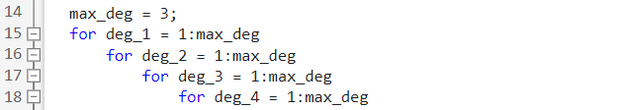
Features
• Our method finds a feature for each dimension $x_{i}$
• We assume the system can be approximated by a polynomial $P(x_{1},x_{2},…,x_{8})$
What we tried:
• First try $P=x_{1}^{d}+x_{2}^{d}+x_{3}^{d}+…x_{8}^{d}$ to approximate the maximum degree
- We found $d=3$ or $d=4$ the fitting errors are better
• Set maximum degree $d_{max}=3$, then use brute force to search all the features
Ye & Shafizur
Linear Feature Engineering
6

Slide 7
Features
• Our method finds a feature for each dimension $x_{i}$
• We assume the system can be approximated by a polynomial $P(x_{1},x_{2},…,x_{8})$
What we tried:
• First try $P=x_{1}^{d}+x_{2}^{d}+x_{3}^{d}+…x_{8}^{d}$ to approximate the maximum degree
- We found $d=3$ or $d=4$ the fitting errors are better
• Set maximum degree $d_{max}=3$, then use brute force to search all the features
- We found maximum degree list (3 2 1 3 3 1 1 3) performs best
- $P=a_{1}x_{1}^{3}+a_{2}x_{1}^{2}+a_{3}x_{1}+{a_{4}x}_{2}^{2}+{a_{5}x}_{2}+…$
Ye & Shafizur
Linear Feature Engineering
7

Slide 8
Comparison
• Capturing mutual information:
- Has more freedom in choosing features than using $X$ as a whole part.
- E.g. we can add feature $x_{1}∗x_{2}$ to "capture" the dependence between dimensions
Ye & Shafizur
Linear Feature Engineering
8

Slide 9
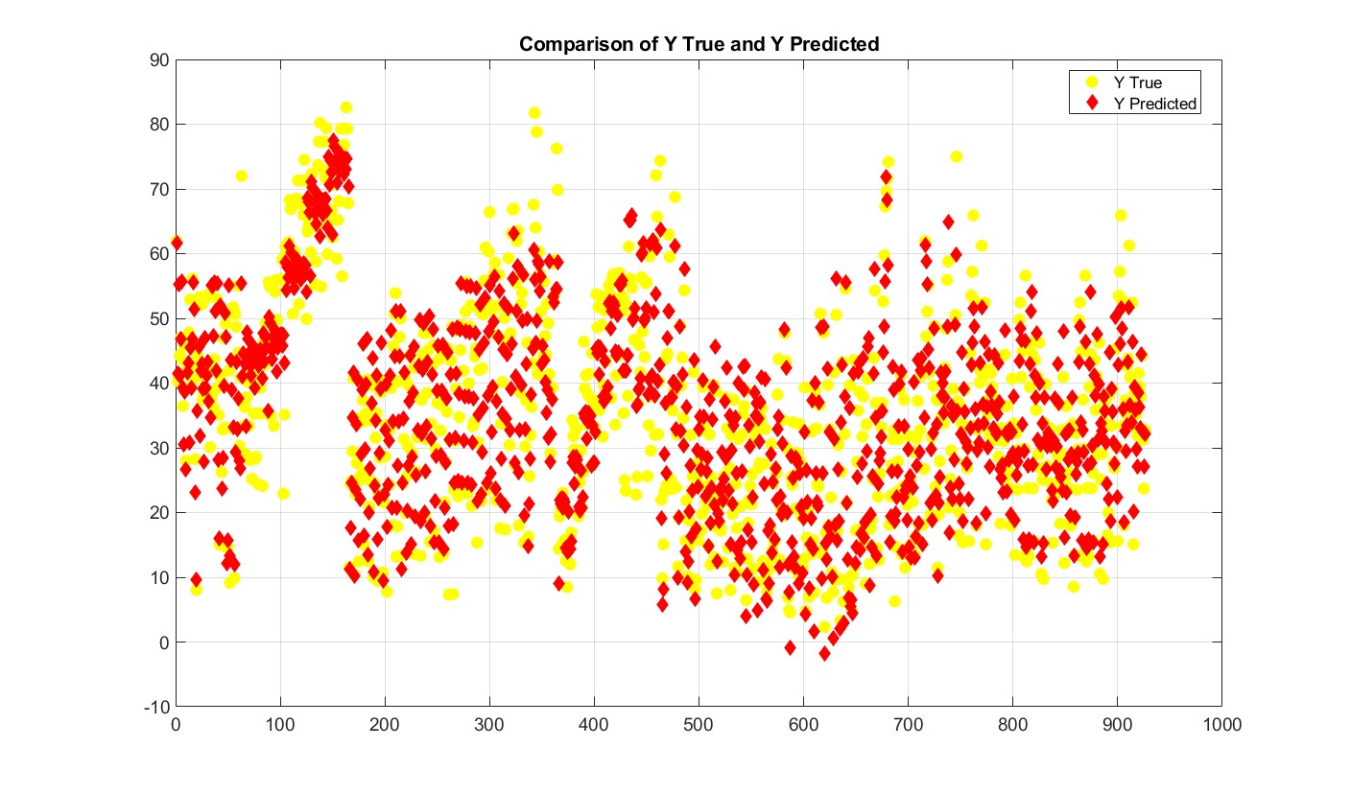
Evaluation
- X-axis represents the index of the values
- Y-axis represents the Y(true)/Y(predicted) values
Ye & Shafizur
Linear Feature Engineering
9

Slide 10
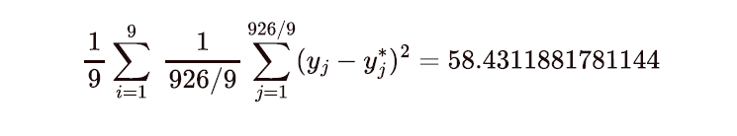
Overfitting
• Cross-validation is a resampling technique that involved partitioning the dataset into
multiple subsets, often referrer to as folds
K = 8 | K= 9 | K =10
60.5016 | 58.4312 | 60.5295
Ye & Shafizur
Linear Feature Engineering
10

Slide 11
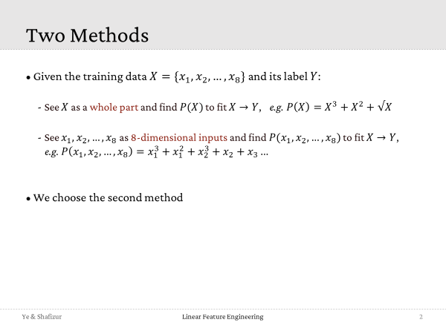
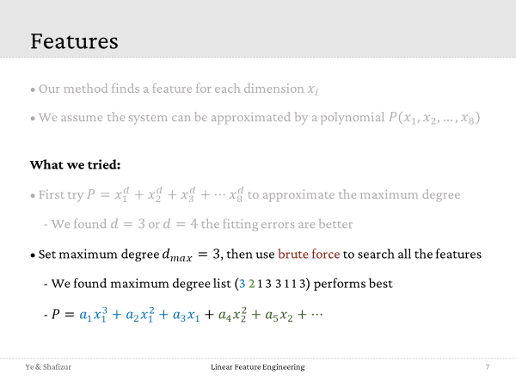
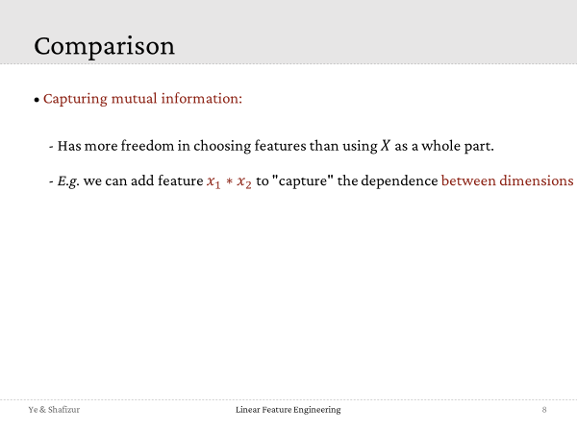
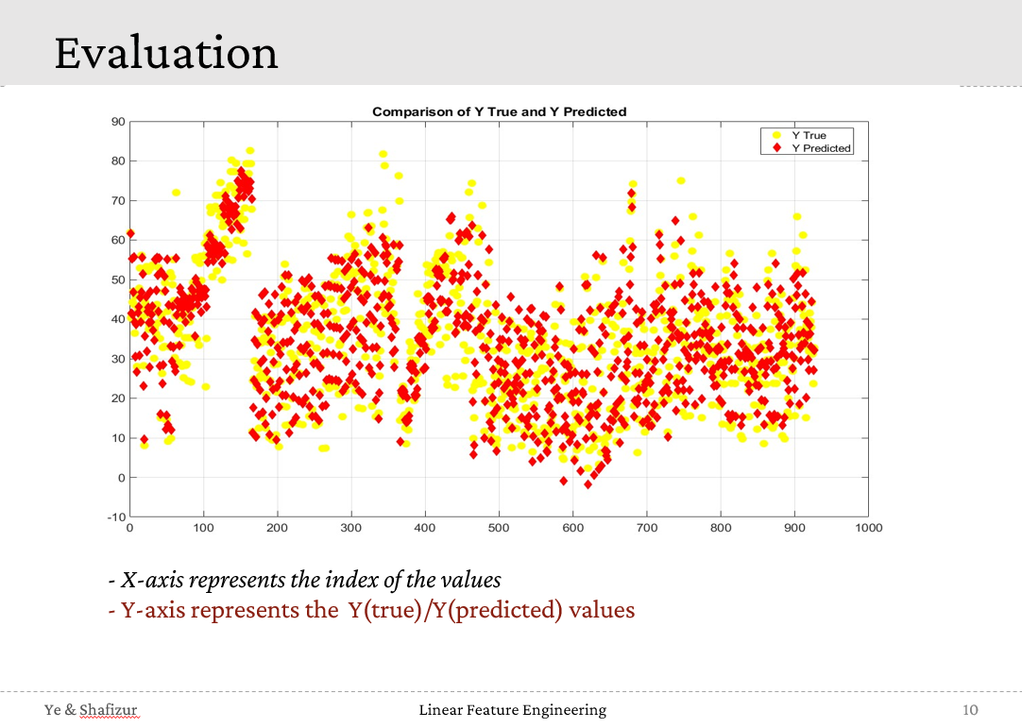
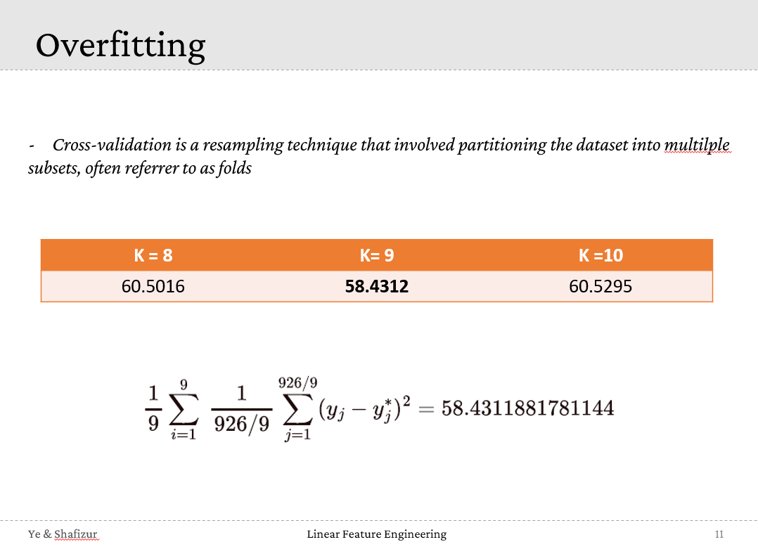

Linear Feature Engineering
Thank you!

